Slide 1
Random Forest(Regression)
K. Jaswanth Reddy

Slide 2


Key Points
Random Forest
Steps of Random Forest Working
Why Use a Random Forest Algorithm?
Decision Trees
Important terms in Decision Trees
Ensemble Learning
Hyperparameters
Advantages and Disadvantages of Random forest

Slide 3
Random Forest
Random forest regression is a supervised learning method that combines multiple decision trees to improve the predictive accuracy of a regression model. In this approach, each decision tree is trained on a different subset of the training data, and the final prediction is based on the average of the predictions of all the trees.
In Random Forest regression, a collection of decision trees is constructed through an ensemble technique known as bagging or bootstrap aggregating.

Slide 4
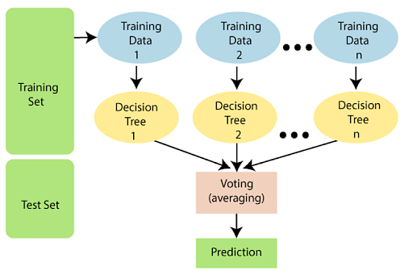
Random Forest Working
Step 1: Select random samples from a given data or training set.
Step 2: This algorithm will construct a decision tree for every training data.
Step 3: Predictions will take place by averaging the decision tree.
Step 4: Finally, select the average of the prediction result as the final prediction result.

Slide 5
Why Use a Random Forest Algorithm?
There are a lot of benefits to using Random Forest Algorithm, but one of the main advantages is that it reduces the risk of overfitting and the required training time. Additionally, it offers a high level of accuracy. Random Forest algorithm runs efficiently in large databases and produces highly accurate predictions by estimating missing data.
Random Forest algorithm used in real-life applications like Predicting future stock prices based on historical data, e-commerce to forecast sales, and the healthcare field to check the diagnosis of disease.

Slide 6
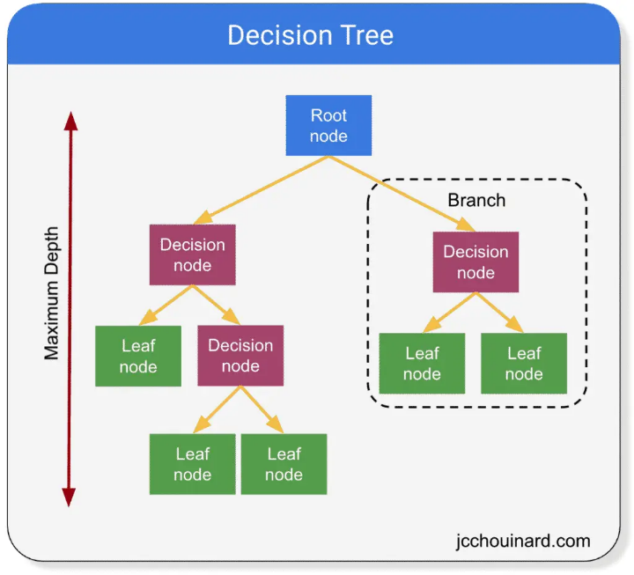
Decision Trees
Decision Tree is a machine learning model that predicts a target variable based on a series of if-else conditions.
It is a tree-like model where internal nodes represent tests on features, branches represent the possible outcomes of the tests, and leaf nodes represent the classification or regression output.

Slide 7

Important terms in Decision Trees
Entropy: It is a measure of randomness or unpredictability in the dataset.
$${S=−\sum_{i=0}^{n}{p_{i}}log}_{2}{p_{i}}$$
where,
S = Entropy
$p_{i}$=probability of randomly selecting an example in class i.

Slide 8
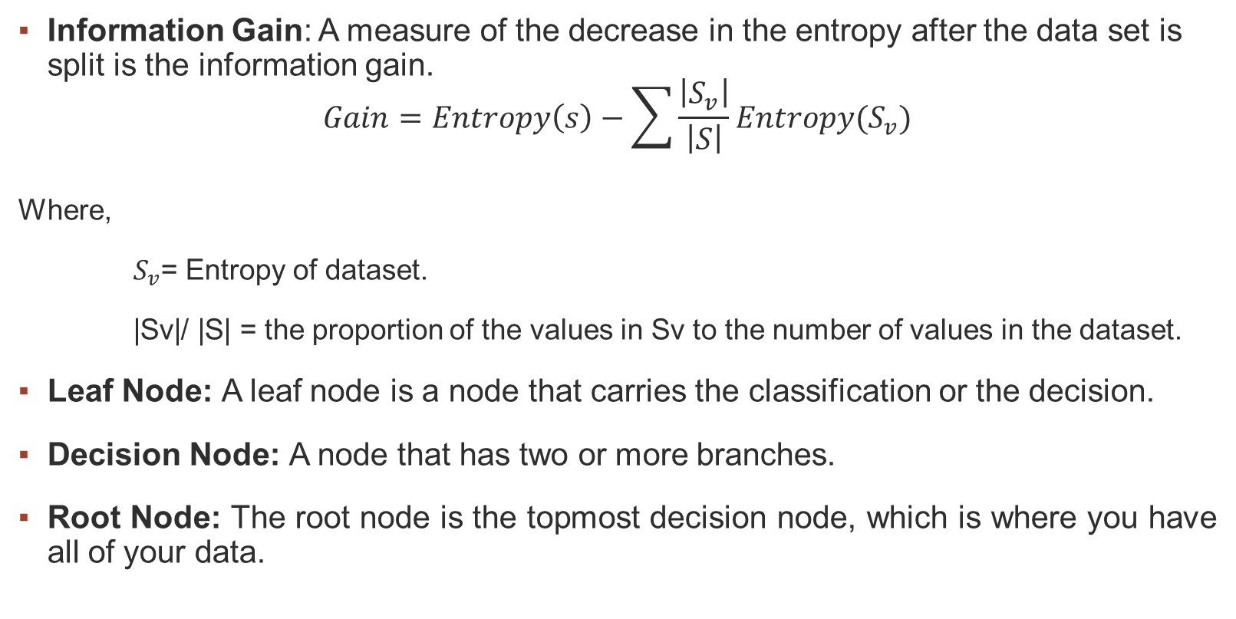
Information Gain: A measure of the decrease in the entropy after the data set is split is the information gain.
$$Gain=Entropy\left(s\right)−\sum{\frac{\left|S_{v}\right|}{\left|S\right|}Entropy(S_{v})}$$
Where,
$S_{v}$= Entropy of dataset.
|Sv|/ |S| = the proportion of the values in Sv to the number of values in the dataset.
Leaf Node: A leaf node is a node that carries the classification or the decision.
Decision Node: A node that has two or more branches.
Root Node: The root node is the topmost decision node, which is where you have all of your data.

Slide 9
The main idea behind decision trees is to split the data into smaller subsets based on the values of the input features that are most important in making a decision. These splits are chosen based on certain criteria, such as maximizing information gain or minimizing impurity, and are usually determined using the Gini impurity or the entropy measure.

Slide 10
Ensemble Learning
Ensemble learning is a process of combining several models or combining the same model several times and predicting the outcome of a dataset.
Ensemble learning can be applied to various types of machine learning models, including decision trees, neural networks, and support vector machines.
Ensemble Learning uses two methods:
Bagging: Creating a different training subset from sample training data with replacement is called Bagging. The final output is based on the average of predictions.
Boosting: Combing weak learners into strong learners by creating sequential models such that the final model has the highest accuracy is called Boosting.

Slide 11
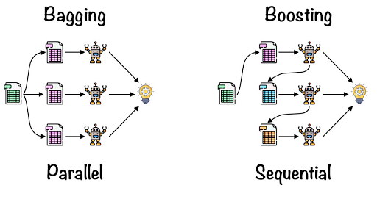
Random forest regression uses bagging over boosting because it builds multiple decision trees independently and in parallel, each tree is built on a random subset of the features and the observations, which reduces the correlation between the trees and the overall variance of the model. In addition, random forest regression can handle both numerical and categorical features, which makes it a robust and flexible method for regression problems.

Slide 12
Hyperparameters
n_estimators: This hyperparameter controls the number of decision trees in the random forest. A higher number of trees can improve the model's performance, but it also increases the computational complexity.
max_depth: This hyperparameter controls the maximum depth of each decision tree in the random forest. A deeper tree can capture more complex relationships in the data, but it also increases the risk of overfitting.
min_samples_split: This hyperparameter controls the minimum number of samples required to split an internal node of a decision tree. A higher value can prevent overfitting, but it may also decrease the model's ability to capture complex relationships.

Slide 13
min_samples_leaf: This hyperparameter controls the minimum number of samples required to be at a leaf node of a decision tree. A higher value can prevent overfitting, but it may also decrease the model's ability to capture complex relationships.
max_features: This hyperparameter controls the maximum number of features that can be used to split each internal node of a decision tree. A lower value can prevent overfitting, but it may also decrease the model's ability to capture complex relationships.
random_state: This hyperparameter sets the random seed for the random number generator used by the algorithm, which can affect the reproducibility of the result.

Slide 14
Advantages of Random forest:
Can perform both Regression and classification tasks.
Produces good predictions that can be understood easily.
Can handle large data sets efficiently.
Provides a higher level of accuracy in predicting outcomes over the decision algorithm.
Disadvantages of Random forest:
While using a Random Forest Algorithm, more resources are required for computation.
It Consumes more time compared to the decision tree algorithm.
Less intuitive when we have an extensive collection of decision trees.
Extremely complex and requires more computational resources.

Slide 15
Thank You

